Slide 1
Contribution of local governments, cities & Non-governmental organization's to the implementation of the Cartagena Protocol on Biosafety:
Opportunities to profile work on the Action Agenda for Nature and People
Mr. Mohamed Elyes KCHOUK
Regional Specialist for francophone Africa for the United Nations Environment Programme (UNEP) – Biosafety Clearing-House (BCH) Project 3
Member of the City Council of Hammam-Lif as
Co-founder of 2 NGOs: North African Network of Taxonomy (NAFRINET)
and the Tunisian Association of Taxonomy (ATUTAX).

Slide 2
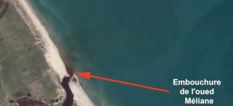
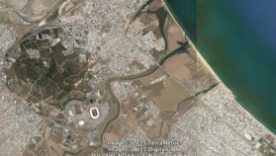

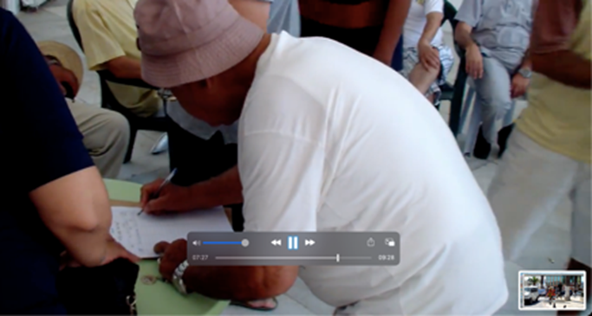
Association for the Safeguarding of the city of Hammam-Lif
-cities can play a role in committing to Biodiversity and biosafety
2015 Campaign to stop pollution of the sea
10,000 Signatures
STOP POLLUTION OF TUNIS BAY (https://www.youtube.com/watch?v=xRnBwR52yj4)
Disappearance of species
Spirographis spallanzanii

Slide 3





Tunisian Association for Taxonomy
-NGOs can play a role in committing to biodiversity and biosafety/ publications and
International Conferences
April 2010
Taxonomy & Biodiversity
April 2013
Biodiversity & Food Security
April 2016
From Genes to Ecosystems

Slide 4

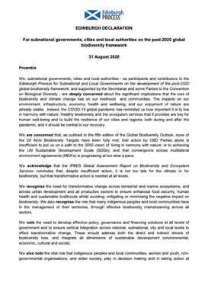
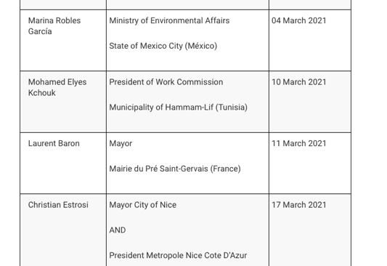
Municipality of Hammam-Lif
-local governments can play a role in committing to biodiversity and biosafety
EDINBURGH DECLARATION
For subnational governments, cities and local authorities on the post-2020 global biodiversity framework
31 August 2020
https://www.gov.scot/publications/edinburgh-declaration-on-post-2020-biodiversity-framework/pages/current-signatories/
10 March 2021
Signature of the Edinburgh Declaration by the Municipality of Hammam-Lif

Slide 5
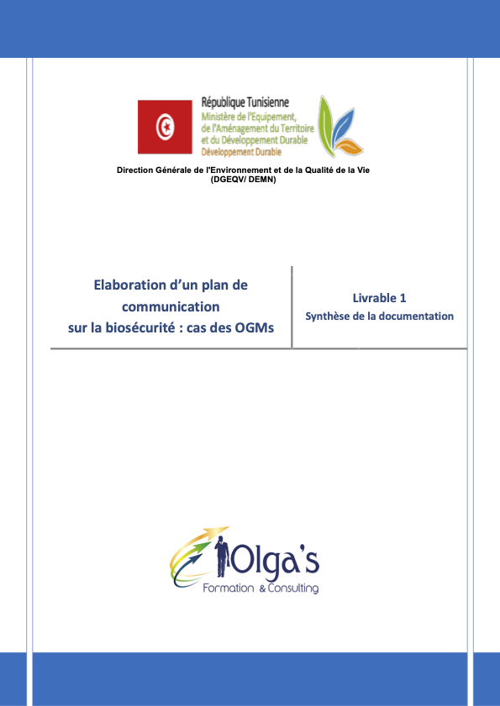
Public awareness, education and participation: a prerequisite for the implementation of the Protocol
NGOs, cities and local governments can mobilize the support from the public to participate in public participation of imports of LMOs
raise awareness of issues relate to the public to governments as an interlinkage between government and the general public.
NGOs, cities and local governments can promote capacity-building.
raise awareness of the Supplementary Protocol on Liability and Redress as it is important and its ratification
Facilitate cooperation and interlinkage between governments and the public .
it can be by 2030
Communication Plan on Biosafety: case of LMOs

Slide 6
UNEP-GEF BCH Projects
-Government’s project with ngos commitment to support
The Biosafety Clearing-House (BCH): A pillar of Cartagena Protocol on Biosafety
The BCH under the Protocol is essential as it (Article 20):
(a) Facilitates the exchange of scientific, technical, environmental and legal information on, and experience with, LMOs
(b) Assists Parties to implement the Protocol, taking into account the special needs of developing country Parties, in particular the least developed and small island developing States among them, and countries with economies in transition as well as countries that are centres of origin and centres of genetic diversity.
NGOs commitment to the Action Agenda could be to by 2030:
Train people on the use of and awareness of the BCH and the Cartagena Protocol on Biosafety
Support the BCH migration to the new platform
Target audiences:
National authorities,
Other stakeholders and the general public
Partners:
Governments,
The general public (any other suggestions)

Slide 7
Status of African Countries
 | decisions | risk Assessments
Benin | 1 | 0
Burkina Faso | 2 | 2
Eswatini | 2 | 1
Ghana | 1 | 1
Kenya | 11 | 11
Niger | 0 | 1
Nigeria | 19 | 18
South Africa | 112 | 110
Sudan | 3 | 3
Uganda | 0 | 1
Zambia | 4 | 6
 | 155 | 154
Date | Decisions | Risk Assessments
2018-08-20 | 10% | 10%
2018-08-22 | 10% | 10%
2018-08-23 | 19% | 21%
 | 39% | 31%
Action/commitment for NGOs for the future:
- Risk assessments conducted on number of decisions on imports using available guidance;
- Sharing of risk assessments through the BCH

Slide 8
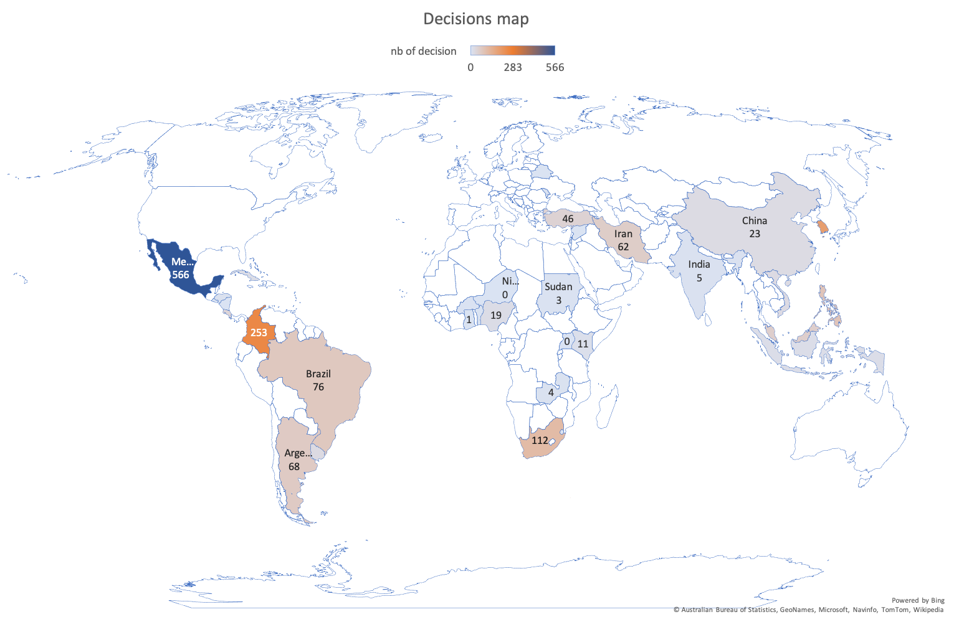

Slide 9
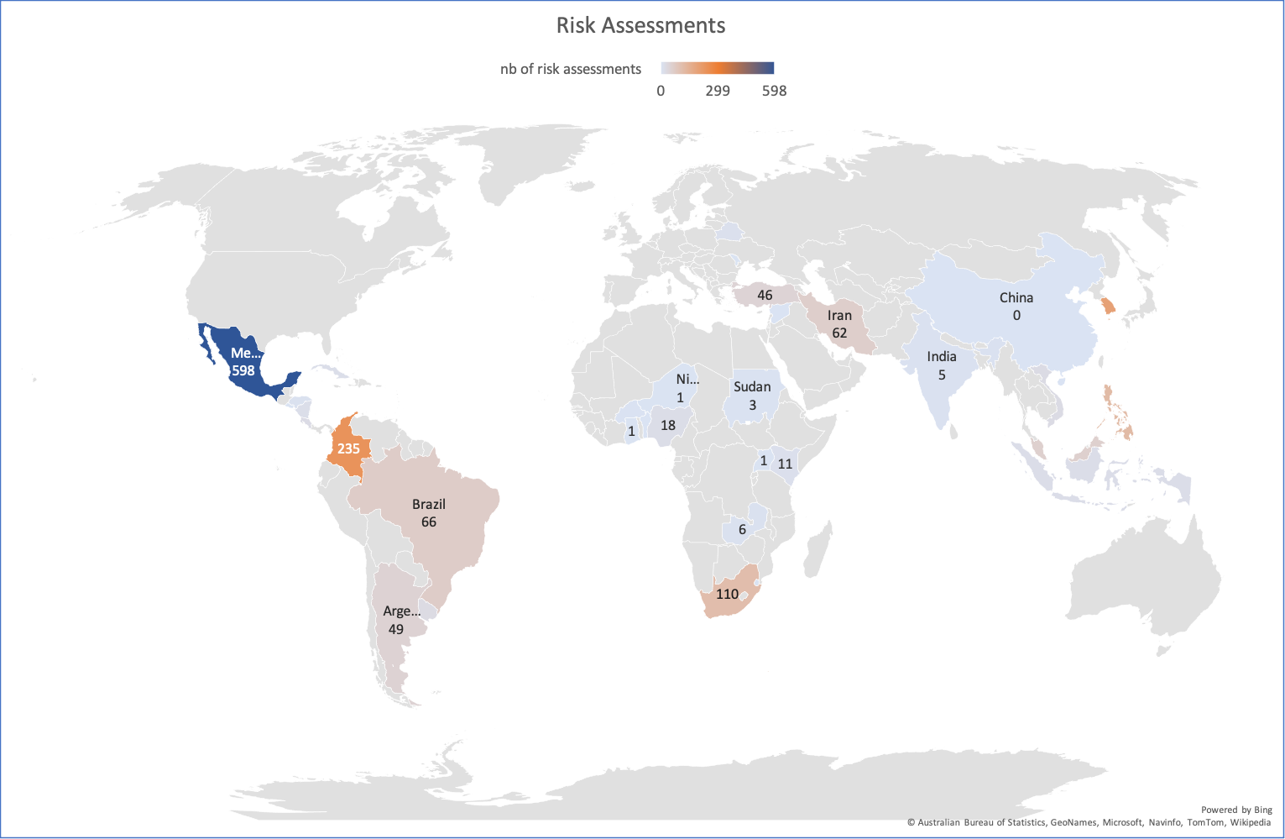

Slide 10
National biosafety frameworks a key to implementing The Protocol
NGOs commitment to the Action Agenda by 2030:
Provide training on the development and implementation of legal, administrative and other measures to implement the Protocol;
Provide support for Parties to carry out biosafety activities set out in compliance action plans
Challenges as benefits:
Governments or Parties can have fully implemented national biosafety frameworks
LMOs can be regulated
Potential risks of LMOs can be addressed to biodiversity or human health

Slide 11
Thank you for your attention
-NGOs and local government are good listeners and bring action among individuals/public on biosafety
Mohamed Elyes Kchouk
mohamedelyes@gmail.com
Mohamed.kchouk1@un.org

